Slide 1

Reduced Order Modelling for Aeroelastic Simulations
Department of Mechanics, Structures and Materials
Aircraft Design Pathway
Authors:
Billton Joseph Vitus
Tutors:
Prof. Joseph Morlier
Oriol Chandre-Vila
26th June, 2020

Slide 2
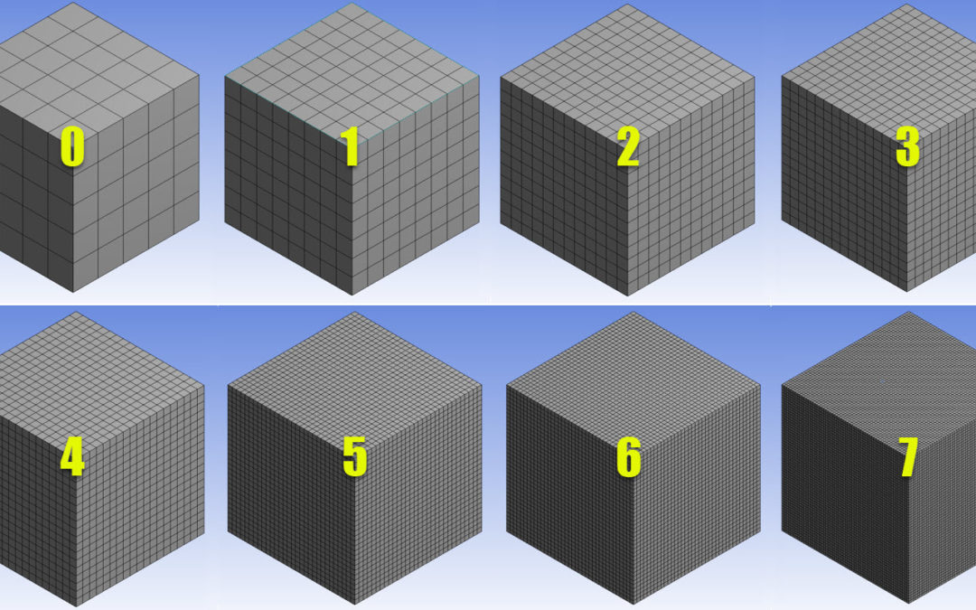
Time? Accuracy?
At 0, solution is quick, but inaccurate.
At 7, solution is highly accurate, but simulation takes a lot of time.
Best scenario for accuracy is 7 and for computation time it’s 0.
Is the best scenario achievable?
Image source: https://cfd.ninja/tag/fine-mesh/

Slide 3
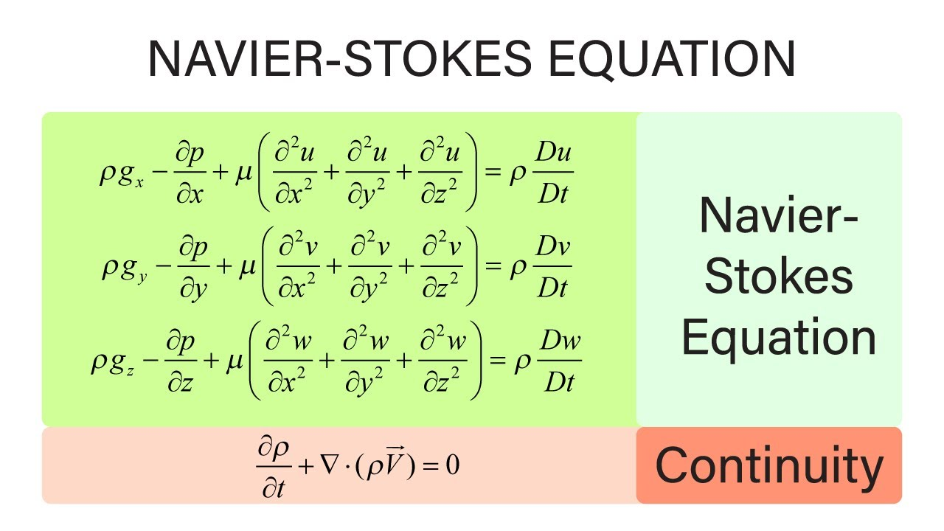
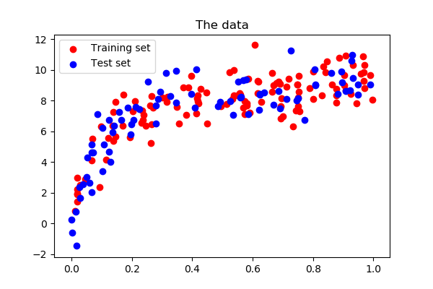
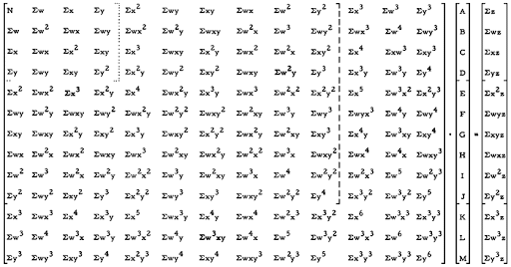
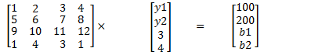
Reduced order modelling
Physics driven modelling
Data driven modelling
Image source: https://scipy-lectures.org/packages/scikit-learn/index.html

Slide 4
State of the Art
Out of all the mathematical formulations available for reduced order modelling, Proper Orthogonal Decomposition (POD) is widely used in industrial and academic studies. (Berkooz, ARFM, 1993; Willcox, AIAA, 2002)
Several techniques exist for creating the snapshot matrix, most prominent one is capturing the output vector at different intervals of time during a high fidelity simulation (Lucia, JOA, 2005).
Another strategy for creating snapshot matrix involves varying analysis conditions and using the final result as vector inputs to the matrix.
Published literature recommend using various strategies to maintain consistency of ROM throughout different analysis conditions, like varying angles of attack, mach number (Liu, AIAA, 2005), structural modes (Thomas, JOA, 2003).

Slide 5
ROM Creation Methodology
Create Snapshot Matrix
Using Hi-Fi Simulations of pre-existent data
Perform PCA of Snapshot Matrix
Find reduced base matrix
Project Reduced Base on Original Equation
Re-dimensionalize the equation
Solve in reduced base
Error correction of ROM

Slide 6
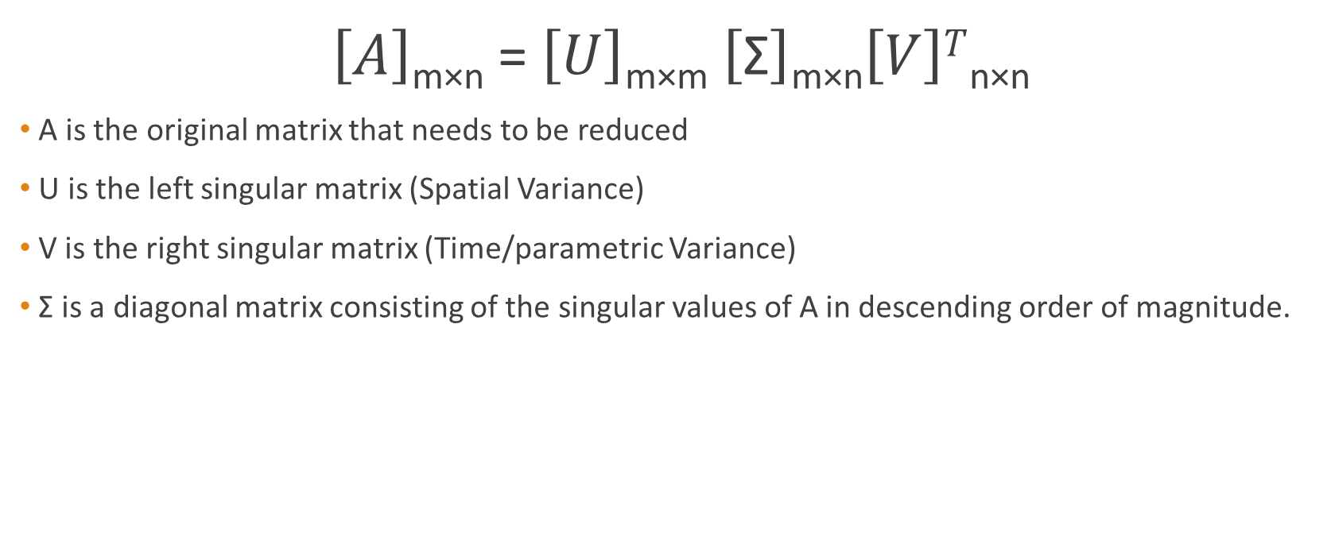
Proper Orthogonal Decomposition
$\left[A\right]$_{m×n} = $\left[U\right]$_{m×m} $\left[\text{Σ}\right]$_{m×n}$\left[V\right]T$_{n×n}
A is the original matrix that needs to be reduced
U is the left singular matrix (Spatial Variance)
V is the right singular matrix (Time/parametric Variance)
$\text{Σ}$ is a diagonal matrix consisting of the singular values of A in descending order of magnitude.

Slide 7
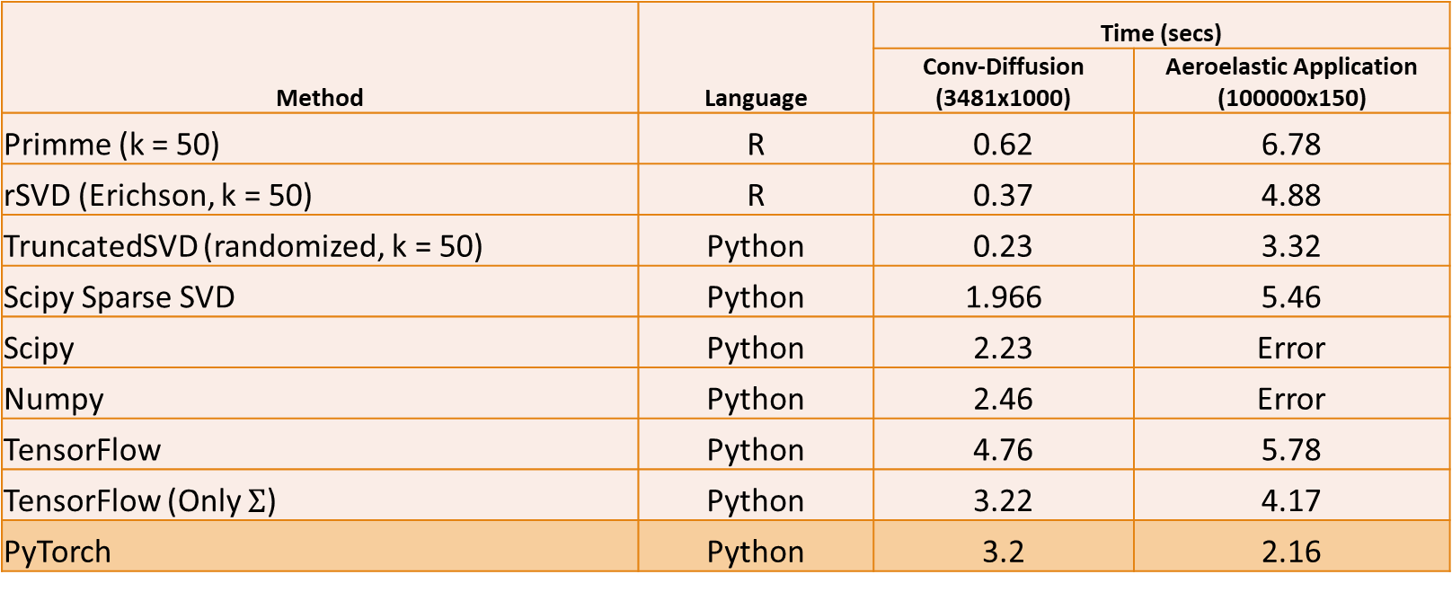
SVD Computation Times
Method | Language | Time (secs)
 |  | Conv-Diffusion (3481x1000) | Aeroelastic Application (100000x150)
Primme (k = 50) | R | 0.62 | 6.78
rSVD (Erichson, k = 50) | R | 0.37 | 4.88
TruncatedSVD (randomized, k = 50) | Python | 0.23 | 3.32
Scipy Sparse SVD | Python | 1.966 | 5.46
Scipy | Python | 2.23 | Error
Numpy | Python | 2.46 | Error
TensorFlow | Python | 4.76 | 5.78
TensorFlow (Only $Σ$) | Python | 3.22 | 4.17
PyTorch | Python | 3.2 | 2.16

Slide 8
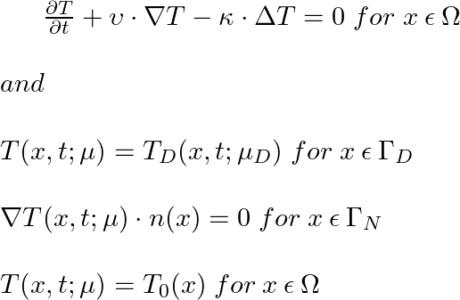
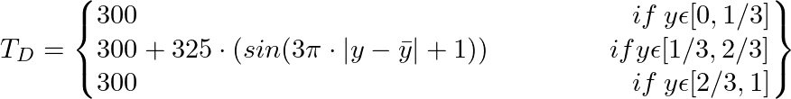




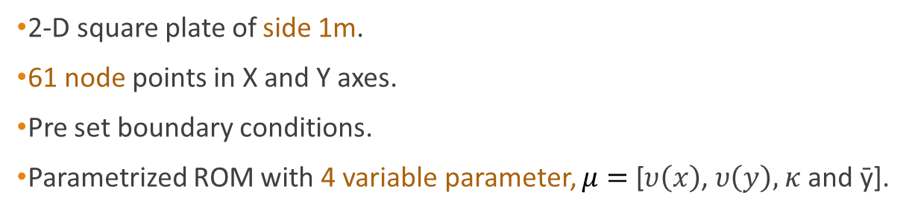





ROM of a Convection-Diffusion Problem
2-D square plate of side 1m.
61 node points in X and Y axes.
Pre set boundary conditions.
Parametrized ROM with 4 variable parameter, $μ=$ [$υ\left(x\right)$, $υ\left(y\right),$ $κ$ and ȳ].
$$1$$
$$Γ_{N}$$
$$Y$$
$$Γ_{D}$$
$$Γ_{N}$$
$$Γ_{N}$$
$$0$$
$$X$$
$$1$$

Slide 9
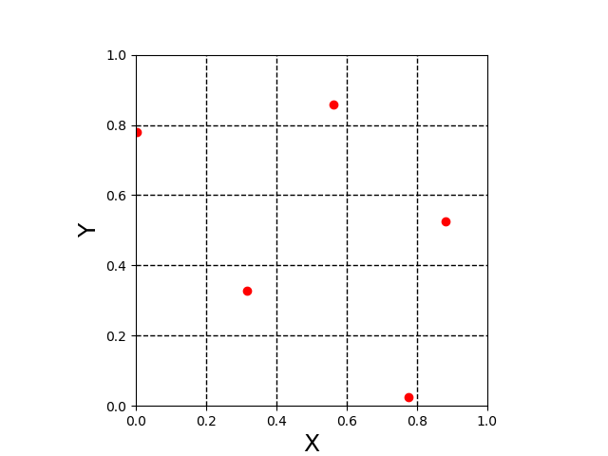

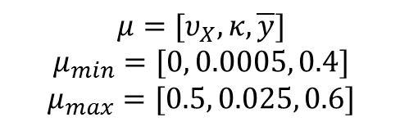

Convection-Diffusion ROM Algorithm
$$μ=[υ_{X},κ, \overline{y}]$$
$$μ_{min}=[0, 0.0005, 0.4]$$
$$μ_{max}=[0.5, 0.025, 0.6]$$
Define Parameter bounds
Upper and lower bound for $μ$
Upper and lower bound for 𝜇
Create design space on n points
Using LHS over $μ$
Using LHS over 𝜇
Perform n hi-fi simulations using generated design space
Create snapshot matrix of n columns using Greedy Algorithm
Solve in reduced base
Perform a POD over snapshot matrix
Find reduced base
Error correction and debugging
$$S=[φ_{1}{ φ}_{2} …{ φ}_{n}]$$
$$S_{r}=\left[φ_{1}{ φ}_{2} …{ φ}_{r}\right], r<n$$
Image source: https://icme.hpc.msstate.edu/mediawiki/index.php/Latin_Hypercube_Sampling_(LHS)

Slide 10
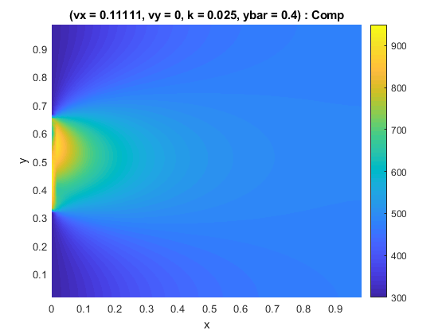
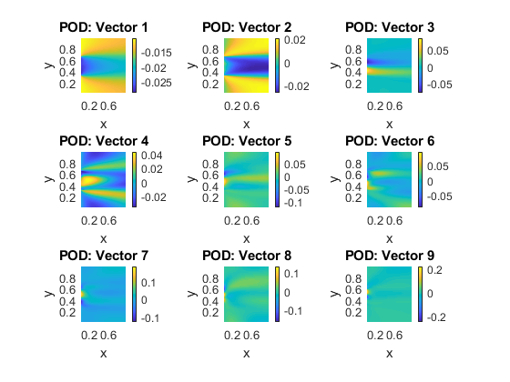


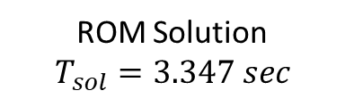
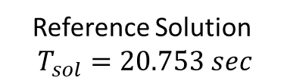
Results of Advection-Diffusion Problem
Reference Solution
$T_{sol}=20.753 sec$
ROM Solution
$$T_{sol}=3.347 sec$$
$$E_{avg}=0.9448\%$$
$E_{max}=6.7095\%$

Slide 11

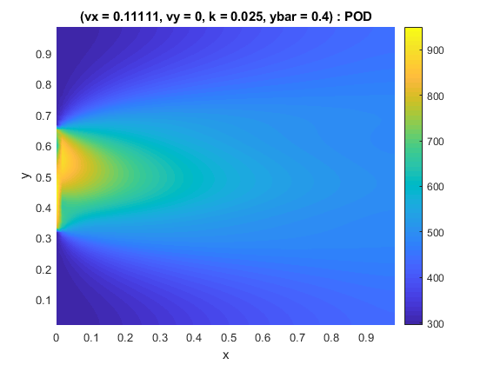
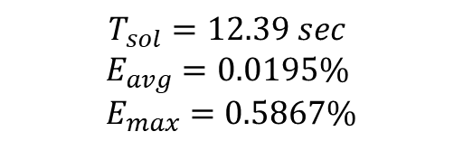


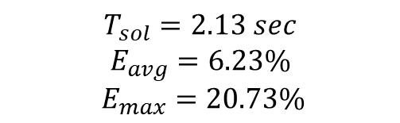
Effect of Sampling Size
$$n=50$$
$$n=4$$
$$T_{sol}=12.39 sec$$
$$E_{avg}=0.0195\%$$
$E_{max}=0.5867\%$
$$T_{sol}=2.13 sec$$
$$E_{avg}=6.23\%$$
$E_{max}=20.73\%$

Slide 12





ROM Algorithm for Aeroelasticity
Create Snapshot Matrix
Using LHS of Hi-Fi struct and aero simulations
Perform PCA of Snapshot Matrix
Find reduced base matrix
Reduced Base Aerodynamic solver
Using aerodynamic Snapshot Matrix
H matrix
Aerodynamic Mesh -> Structural Mesh
Reduced Base Structural Solver
Using structural Snapshot Matrix
Error correction of ROM
$$S=[φ_{1}{ φ}_{2} …{ φ}_{n}]$$
$$S_{r}=\left[φ_{1}{ φ}_{2} …{ φ}_{r}\right], r<n$$
$$A_{r }×Γ_{r}=F_{A−r}$$
$$F_{S}=H^{−1}F_{A}$$
$$K_{r }×U_{r}=F_{s−r}$$

Slide 13
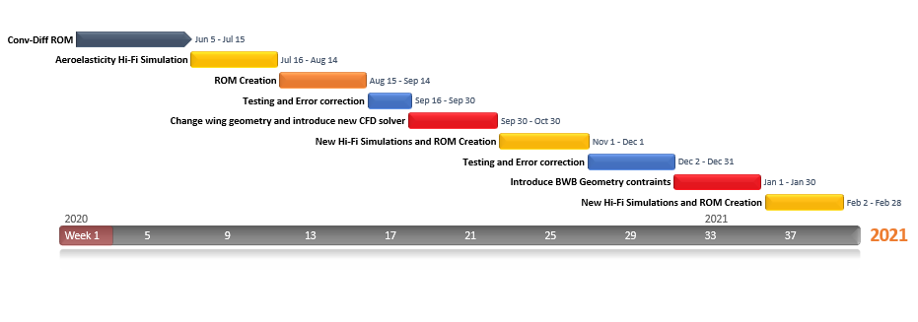
Gannt Chart for S3

Slide 14
Bibliography
Berkooz, G., Holmes, P., & Lumley, J. L. (1993). The proper orthogonal decomposition in the analysis of turbulent flows. Annual review of fluid mechanics, 25(1), 539-575.
Willcox, K., & Peraire, J. (2002). Balanced model reduction via the proper orthogonal decomposition. AIAA journal, 40(11), 2323-2330.
Thomas, J. P., Dowell, E. H., & Hall, K. C. (2003). Three-Dimensional Transonic Aeroelasticity Using Proper Orthogonal Decomposition-Based Reduced-Order Models. Journal of Aircraft, 40(3), 544–551. doi: 10.2514/2.3128
Lieu, T., & Farhat, C. (2005). Adaptation of POD-based Aeroelastic ROMs for Varying Mach Number and Angle of Attack: Application to a Complete F-16 Configuration. 2005 U.S. Air Force T&E Days. doi: 10.2514/6.2005-7666
N. Benjamin Erichson, Sergey Voronin, Steven L. Brunton, & J. Nathan Kutz (2019). Randomized Matrix Decompositions Using R,Journal of Statistical Software, 89(11), 1–48.
Chandre-Vila, O. (2018). Structural Wing Model Reduction in Fluid-Structure Interactions. Retrieved June 24, 2020, from https://github.com/mid2SUPAERO/PGD-ROM_CHANDRE
Chandre-Vila, O. (2019). POD+K for Real-Time Aeroelastic Pre-design Problem. Retrieved June 24, 2020, from https://github.com/mid2SUPAERO/POD-K_v2-CHANDRE

